Slide 1
Внеклассное мероприятие, проводимое в рамках недели английского языка для учащихся 2-9 классов
Фестиваль знатоков английского языка
THE WORLD IS IN CHILDREN’S HANDS
Учитель английского языка
МОУ «Никольская ООШ»
Степанова Наталья Георгиевна

Slide 2
THE HOLIDAY OF ENGLISH LANGUADGE

Slide 3
The English language is the language of friendship

Slide 4
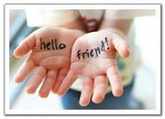
PEACE, CHILDHOOD, FRIENDSHIP

Slide 5
ENGLISH ALPHABET
THE ABC

Slide 6
GAME
TAKING STEPS
SPELL THE WORDS, PLEASE

Slide 7
1-st TEAM
2-nd TEAM
NAME
FACE
BOX
SIX
FIVE
HE
DAD
PIG
CAT
LIKE
FACE
DOG
BIG
TIM

Slide 8
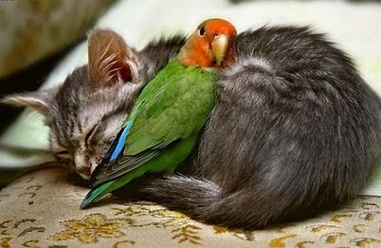
ANIMALS

Slide 9
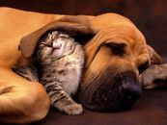
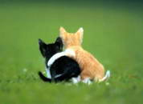
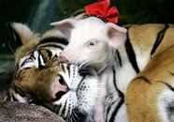
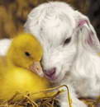
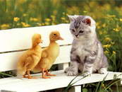

Slide 10
MATCH THE PICTURES AND THE WORDS
A CAT A DOG A FOX A WOLF A MOUSE
A TIGER A LION
A BEAR A MONKEY

Slide 11
Draw a picture
Draw your favorite pet

Slide 12
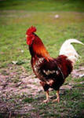
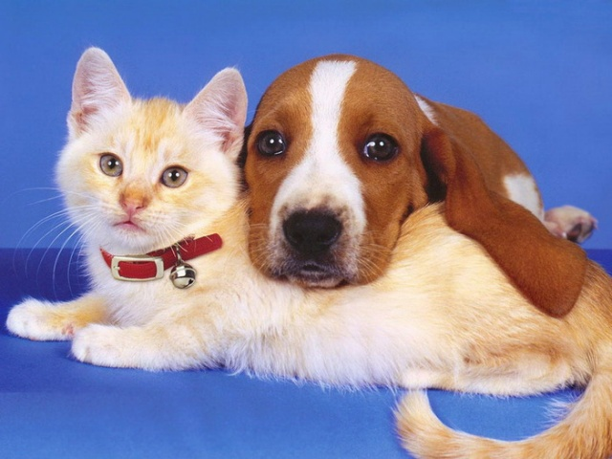
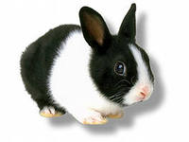

Slide 13
Relaxation
FOR
SPECTATORS

Slide 14
RHYME - TIME
CAT –
PLATE –
CAR –
FLOOR –
BOOK –
LAMP –
HOUSE –
OUR –
PEN –
BAG
LIGHT –
DAY –
TREE –
CHALK –
NAME –
FEET –
FACE –
FORK –
SPOON –
STREET

Slide 15
GAME “HOT POTATO”

Slide 16
THE MORE WE ARE TOGETHER, THE HAPPIER WE ARE

Slide 19
THANK YOU FOR YOUR ATTENTION

